Slide 1
Functionality using verify portal
Powered By

Slide 2
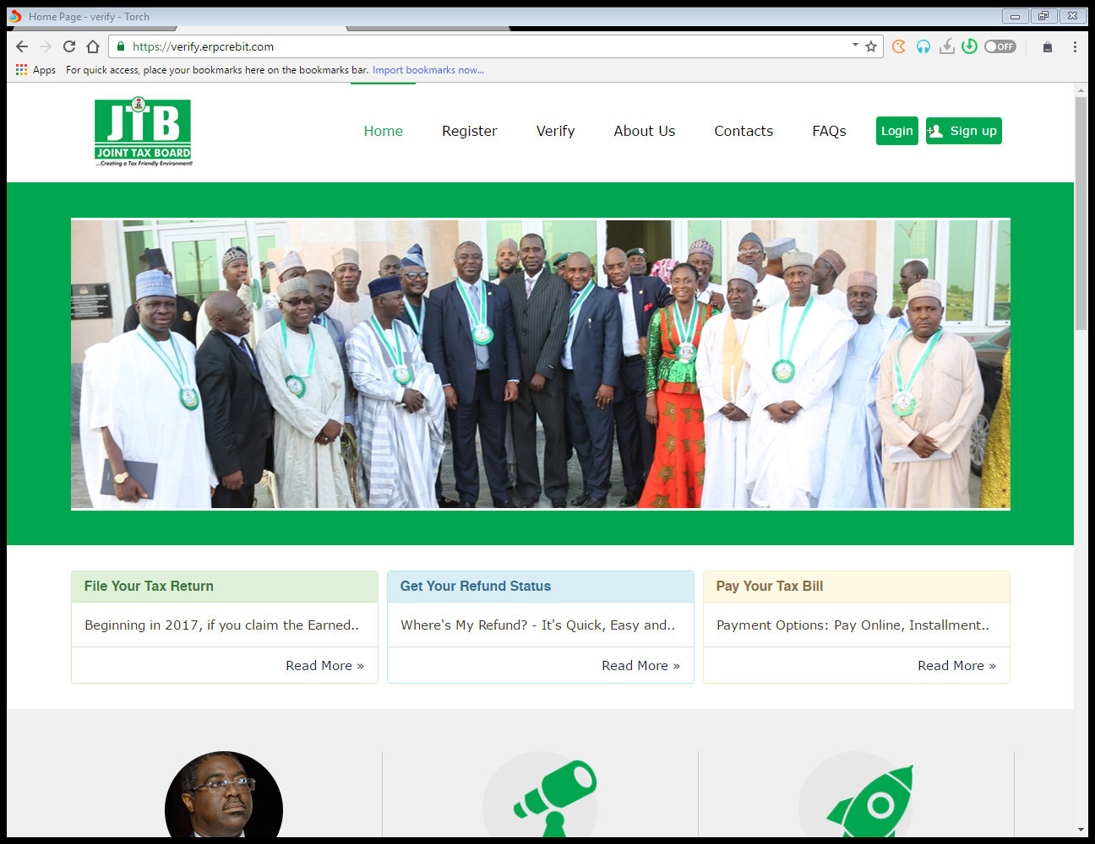
HomePage
Login
Sign up
Videos

Slide 3
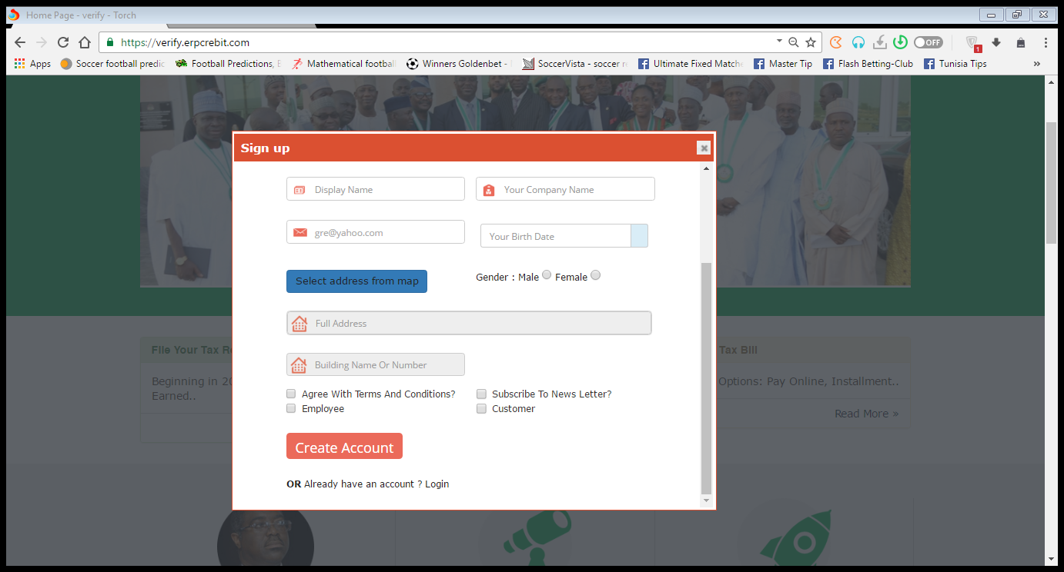
Sign-Up
You will be required to key in your email address before accessing the sign up form.
Enter details appropriately and click Create Account, once created a system generated password will be sent to your mail.

Slide 4
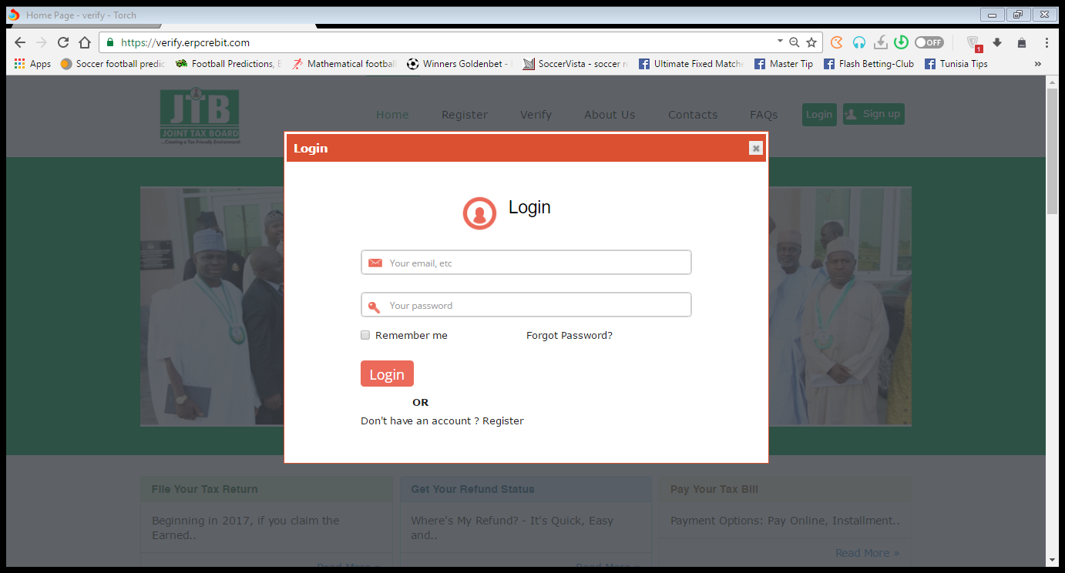
Login
Enter your email and system generated password to login
In the case where a user forgets his/her password, click on the forgot password link.

Slide 5
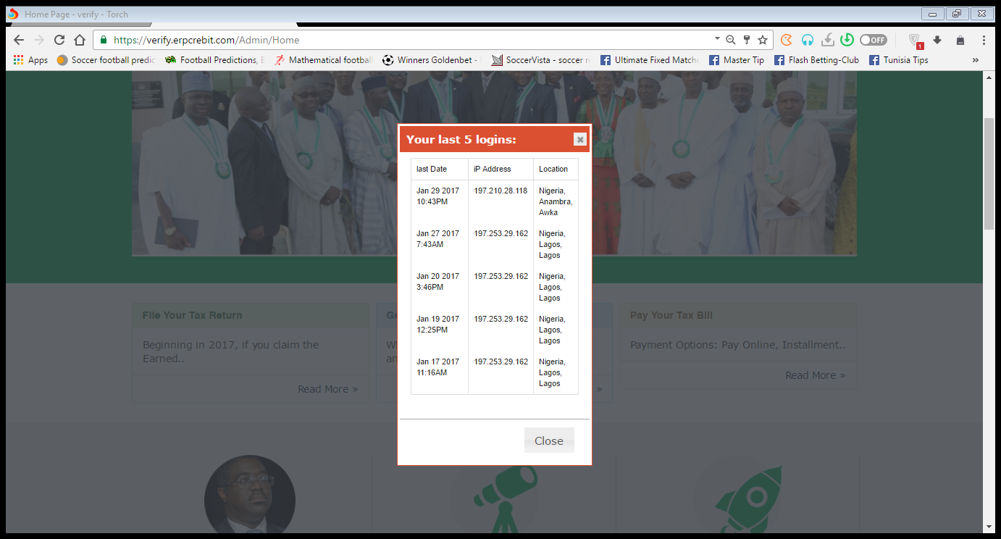
Login IP Security Check
IP security box which shows your last 5 logins and corresponding locations.

Slide 6
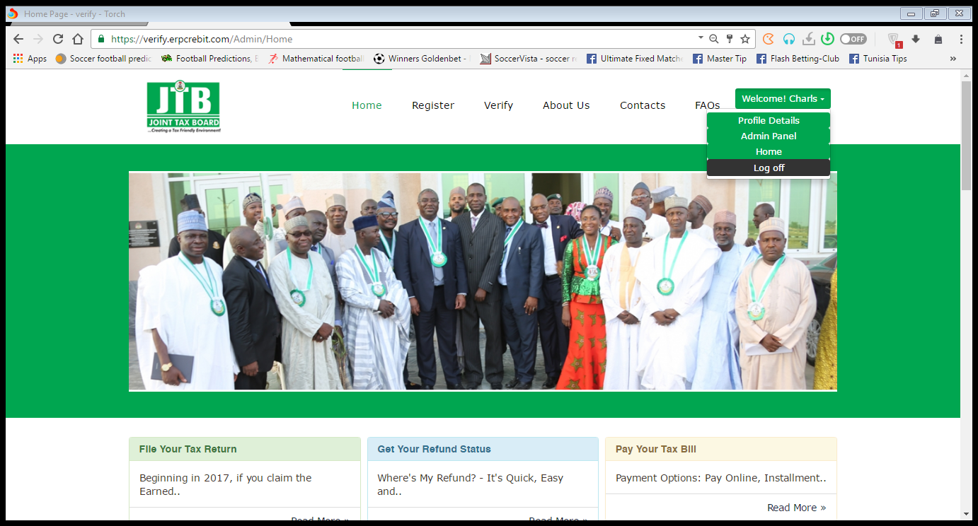
Welcome Page
Under the welcome tab, you can access the profile details and admin panel.

Slide 7
Profile Details
Users can edit profile here.

Slide 8
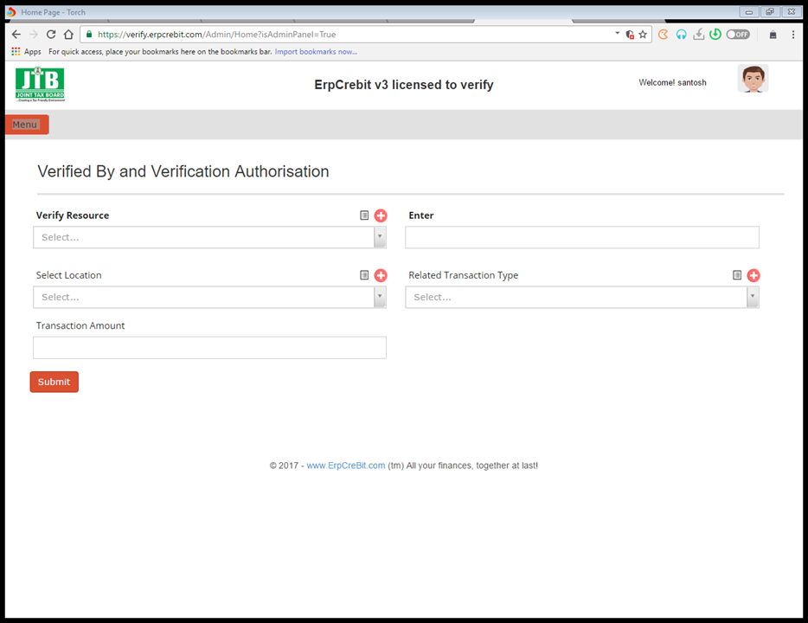
Verified by and Verification Authorization
Verify resource type
Related Transaction Type
Select Location
Transaction Amount

Slide 9
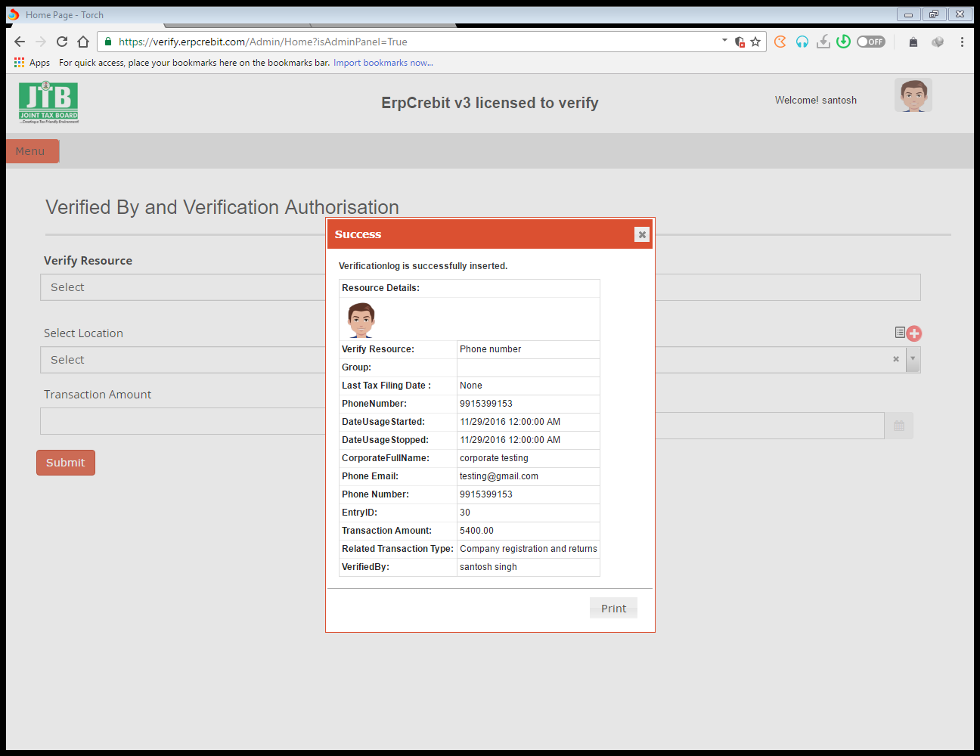
Verification Log
Success verification Page.

Slide 10
Thank You

